Slide 1
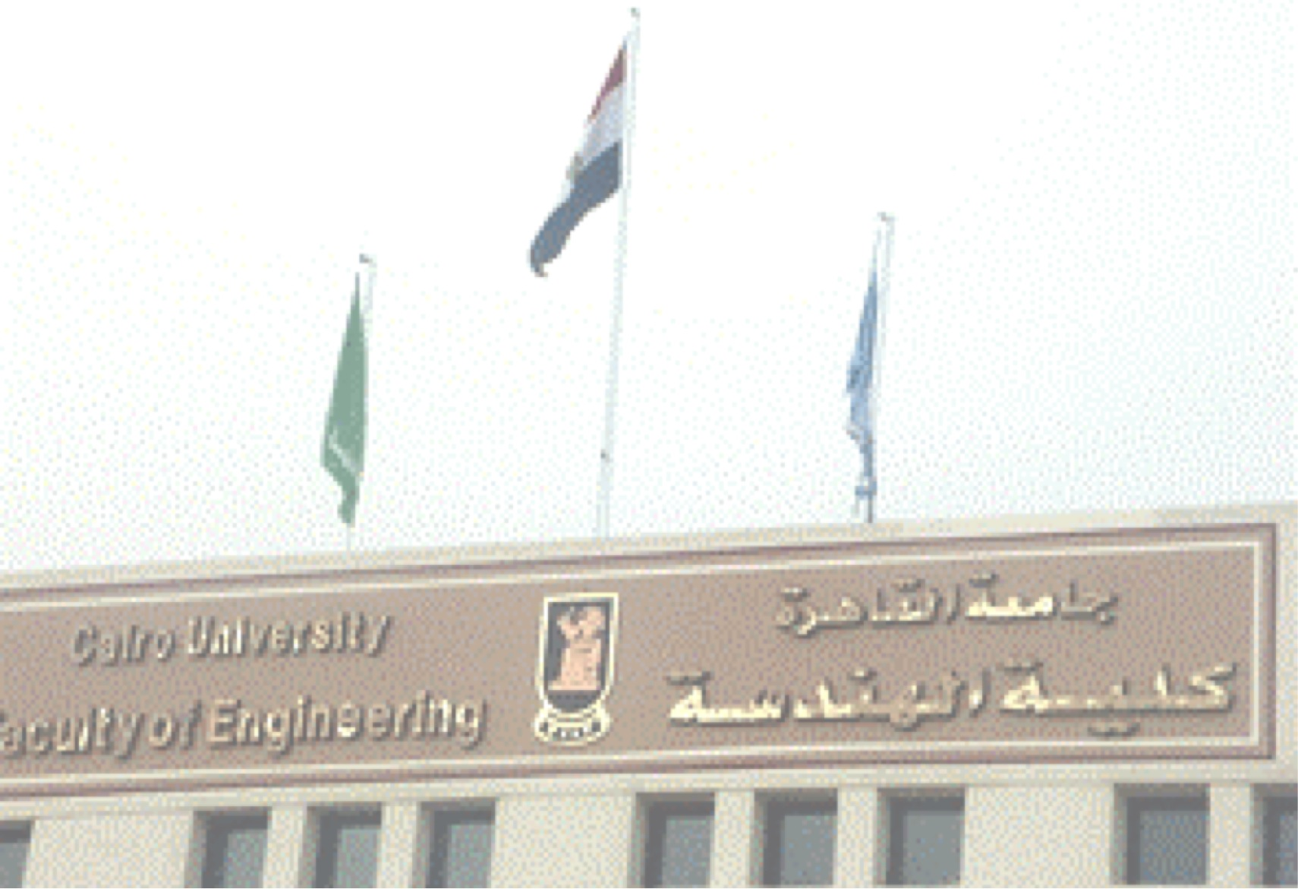
Introduction
To Wireless Networks and Mobility

Slide 2
Syllabus
Physical Layer for Wireless Transmission
Wireless LANs, IEEE802.11
Cellular Concepts
Wireless and Mobility in the Internet

Slide 3
Course Learning Outcomes
On successful completion of the course, students will be able to:
1 | Identify the basic problems, limitations, strengths and current trends of mobile computing
2 | Explain and Analyze the scope and architecture of the 802 Network Technology Family. Be able to associate the 802 architecture to the OSI Reference model with proper mapping of protocol layers.
3 | Describe and analyze the IEEE 802.11 Protocol « WIFI » , its architecture, station services, basic MAC features, MAC Frame Format and Message types, quality of service, and Power Management.
4 | Describe and Analyze the performance of Ad-Hoc network protocols
5 | Describe and differentiate four generations of wireless standard for cellular networks
6 | Analyse and critique the performance of different networks and algorithms for mobile computing (IP, TCP protocols)
7 | Practice research techniques and investigation methods

Slide 4
References
Main reference
  “IEEE 802.11 Tutorial”, By Mustafa Ergen, June 2002*
  “802.11 Wireless Networks, The Definitive Guide” by Matthew Gast Publisher : O'Reilly
  “Ad Hoc Wireless Networks: Architectures and Protocols”
  by C. Siva Ram Murthy and B. S. Manoj
Other references
  A Technical Tutorial on the IEEE 802.11 Protocol
    http://www.sss-mag.com/pdf/802_11tut.pdf
  “Wireless Communications ”, by Theodor S. Rappaport, 2nd Edition, Prentice Hall, 2002
  “Principles of Wireless Networks” , Kaveh Pahlavan & P. Krishnamurthy, Prentice Hall 2002
Notes:
* http://wow.eecs.berkeley.edu/ergen/docs/ieee.pdf

Slide 5
References
Other references (cont)
  “IEEE 802.11 Handbook: A Designer’s Companion” by Bob O’hara & Al Petrick
  “IEEE Std doc” IEEE 802.11 Standard
  “Wireless Communications and Networks”,William Stallings, Prentice Hall 2002
  “The GSM Network ”, Joachim Tisal, Wiley 2001, ISBN 0 471 4 9816 5

Slide 6
Presentation Topics
Network Layer: Mobile Ad-hoc Networks, Energy Efficient Routing, Multicast routing, IPv6 over PANs, Ad-hoc network auto-configuration, Mobility for IPv4, Mobility for Ipv6, Network Mobility, Signaling and Handoff in IPv6, Localization in Wi-Fi Networks, Localization in 3G, Localization in 4G, Wireless Mesh Networks, Vehicular networks, Virtualization,
Applications: WAP, Mobile TV, Voice over Wireless, Mobile Multimedia, IP Telephony over Mobile Networks, Wireless Games, Medical Applications of Wireless, Multimedia over 802.11, Inter-Vehicular Wireless Communication
Transport Layer: TCP over Wireless
Security: 802.11 security issues, Wireless, Cellular, Ad-hoc, Sensor, Security Issues in Mobility, Security devices for Wireless
Management: Radio Spectrum Management

Slide 7
Presentation
Deadline for sending the presentation to be announced later.
Send in power point or PDF format

Slide 8
Grading
Presentation/ Labs/ Quiz : 20%
Midterm: 10 %
Final: 70%

Slide 9


Wired Vs. Wireless
Electromagnetic waves
Wired | Wireless
Each cable is a different channel
One media (cable) shared by all
Signal attenuation is low
High signal attenuation
Virtually No interference
High interference
noise; co-channel interference; adjacent channel interference

Slide 10
Why go Wireless
Advantages
  Sometimes it is impractical to lay cables
  User mobility
  Cost
  Flexibility
Limitations
  Bandwidth
  Fidelity
  Power
  Security
  Slower Hardware validation

Slide 11
Wireless Historical Overview
Origins of Coded Transmission
1793, Revolutionary France (Optical Telegraph)
  Aerial Telegraph, invented by Claude Chappe
  Extensive network throughout France
1840s, Samuel F. B. Morse
  Coded transmission via electronic means
  Rapidly spread throughout US and Europe
  International Telegraph Union (ITU) formed in 1865

Slide 12
Wireless Historical Overview
Submarine Telegraphy: High-Tech of 19th Century
1850: Dover-to-Calais, first submarine line
1858: First transatlantic cable
  Breaks after 3 months!
  President Buchanan & Queen Victoria exchange telegrams
1866: Relayed with higher quality cable
  Development of cable materials, technology of laying, repair
Typical “Performance”:
  1870: London to Bombay in 4 minutes, 22 seconds
  1901: London to British Guiana, 22 minutes
  1924: Telegram around the world in 80 seconds!

Slide 13
Wireless Historical Overview
Radio Telegraphy (AKA “Wireless”)
Radio technology
  Communicate with ships and other moving vehicles
  Messages sprayed into the “ether” crossing north Atlantic boundaries
1896: Guglielmo Marconi (1874-1937)
  First demonstration of wireless telegraphy
  Built on work of Maxwell and Hertz to send and receive Morse Code
  Based on long wave (>> 1 km), spark transmitter technology, requiring very large, high power transmitters
  First used by British Army and Navy in the Boer War (1880–1881) and (1899–1902)

Slide 14
Wireless Historical Overview
1907: Commercial Trans-Atlantic Wireless Service
  Huge ground stations: 30 x 100m antenna masts
  Beginning of the end for cable-based telegraphy
World War I: Rapid development of communications intelligence, intercept technology, cryptography
1920: Marconi discovers short wave (<100 m) radio
  Long wave follow contour of land
    Very high transmit power, 200 KW+
  Short waves reflect, refract, and absorb, like light
    Bounce off ionosphere
    Higher frequencies made possible by vacuum tube (1906)
    Cheaper, smaller, better quality transmitters 1960s

Slide 15
